Slide 1


MyCOAST PROYECT: T90 Program: User Guide
Sara Cloux González
Jose A. Moares Guedes
Vicente Pérez Muñuzuri

Slide 2
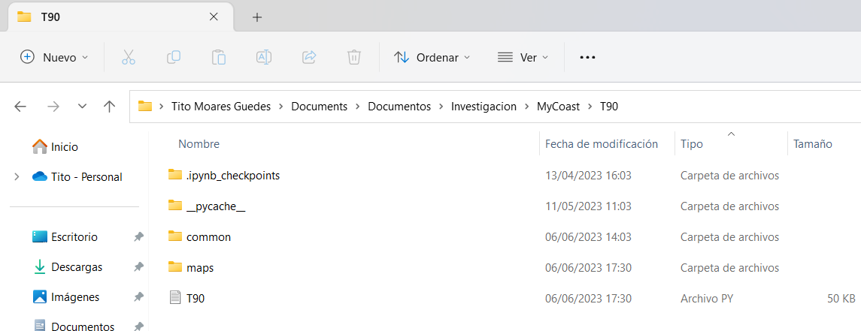
Previous Steps
First download the T90 folder and save it in a known working directory. The contents should NOT be deleted.
In 'common' there are a number of auxiliary programs necessary for the correct operation of T90.py
In the 'maps' folder the plots will be stored automatically.
The program to be opened is called T90 (.py format).
Finally, open the T90 program, verify that you are in the correct working directory and check that you have all the necessary modules to work with in the program.

Slide 3
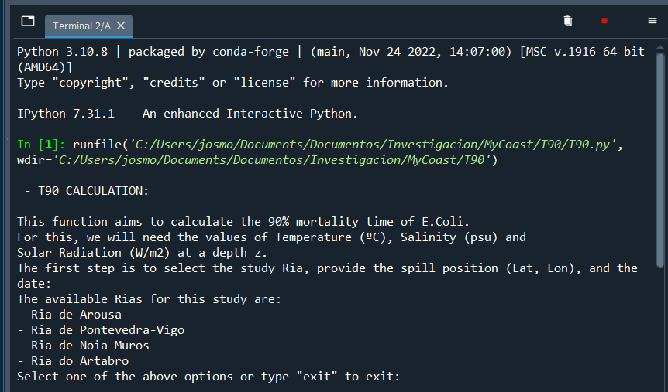
Previous Steps
Run code and check that this message is displayed on the terminal.
To obtain the final results it is necessary to know the position of the spill (Lat, Lon) and the date when it occurs.
Once the position is known, the Ria in which it is located must be indicated first.
In addition, the values of temperature, salinity, solar irradiation and depth at that position will have to be entered.
In the following slides we will show several practical cases as an example of how the program works.

Slide 4
Case 1: Easier case
Suppose a surface spill (z = 0 m) occurs in the Ria de Arousa at (42.610928, -8.918676) on 11/11/2021 at 3:00.
As an example let's say the salinity was 30 psu, at T = 13°C with 0 W/m2.
It is always recommended that the user provide their own data if available. This will make it much simpler and faster to run the program.

Slide 5
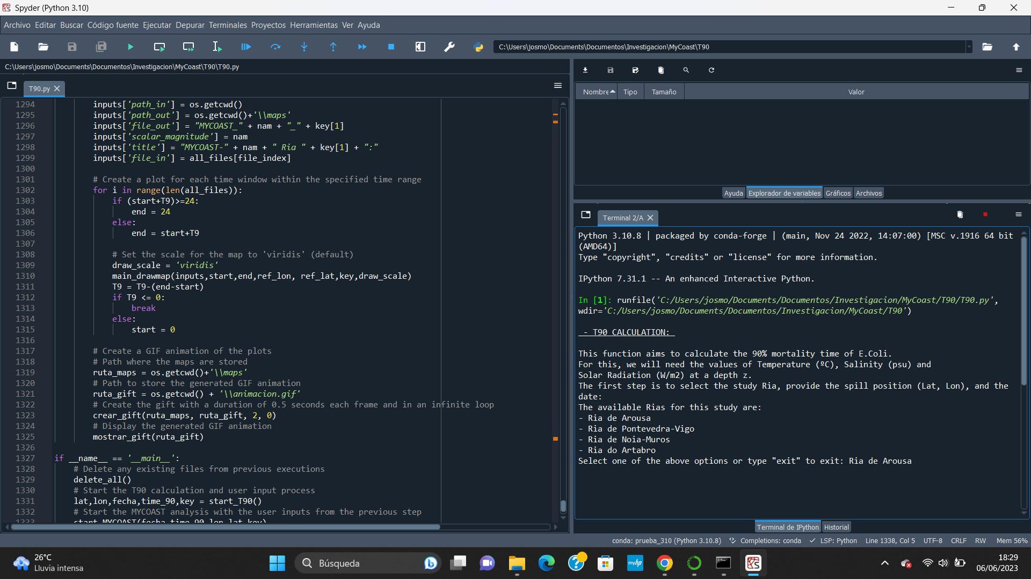
Case 1: Easier case
Run code and introduce the
study area.

Slide 6
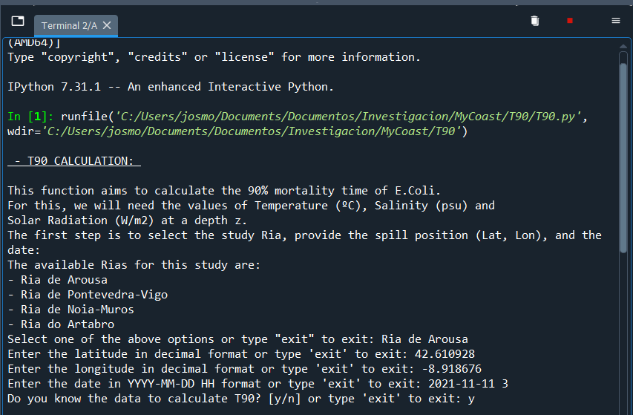
Case 1: Easier case
Introduce the latitude, longitude and the date.
Then, enter 'y' to the question because we know the data.

Slide 7
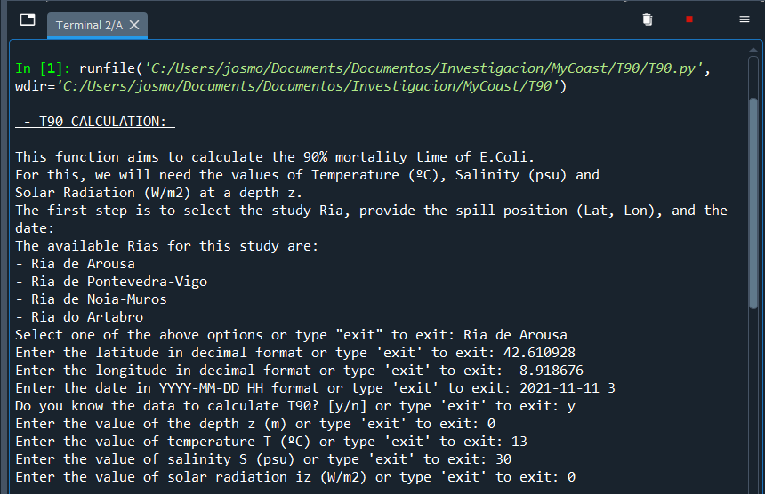
Case 1: Easier case
The next step is to enter the values of the variables as they are indicated.

Slide 8
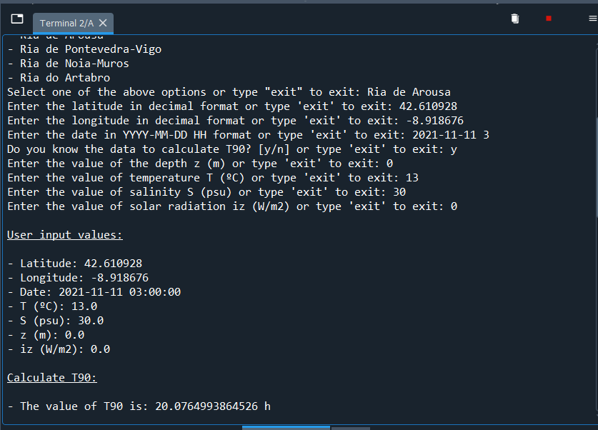
Case 1: Easier case
Following this, the relevant data used to calculate the T90 value and the value obtained for T90 are shown grouped together.

Slide 9
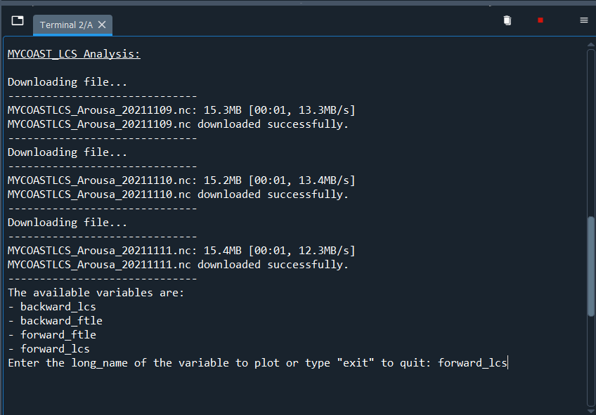
Case 1: Easier case
Right after that, the files needed to create the maps are automatically downloaded.
In addition, the user is asked to enter the variable to be represented for analysis. We are interested in 'forward_lcs' because it is the one that corresponds to the repellent barriers and will prevent the advance of the spill.

Slide 10
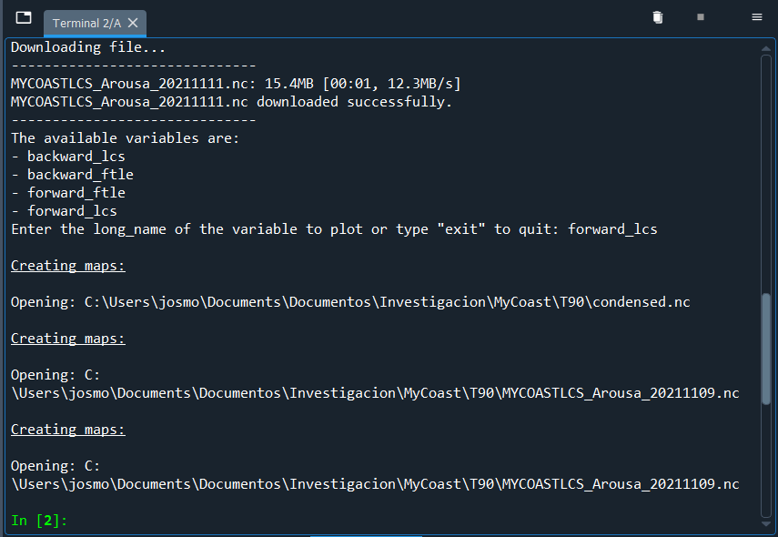
Case 1: Easier case
Finally, the maps are created and at the end of the process a final map and a gift will be displayed on the screen.

Slide 11
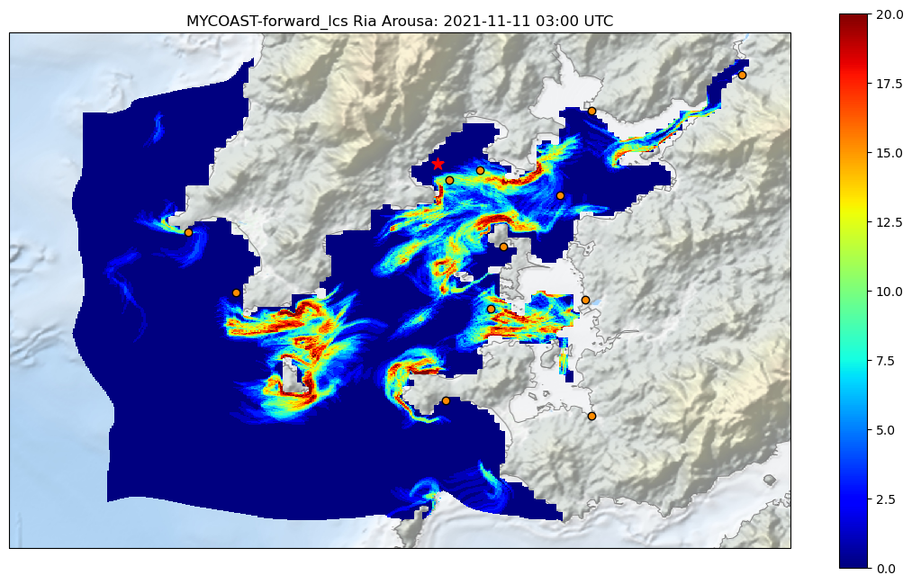
Case 1: Easier case. Results
This would be the main product. The positions of the barriers during T90 are shown. The reddest areas would be the areas that the spill could not pass through, therefore the affected areas would be the bluest ones.
The red star indicates the position of the discharge entered by the user and the orange dots correspond to the positions of the WWTP discharge points (data in excel in the 'common' folder).

Slide 12
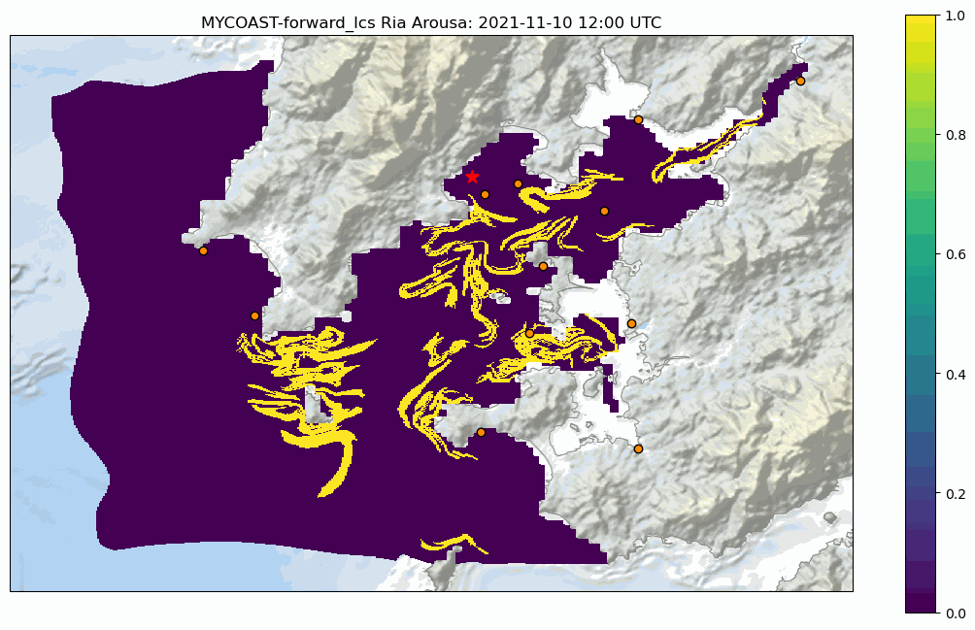
Case 1: Easier case. Results
In addition, this gift is generated to show how the barriers evolve hourly during T90.

Slide 13
Case 2: Consulting case
Suppose a spill occurs in the Ria de Arousa at (42.610928, -8.918676) on 11/11/2021 at 3:00. But the values of the variables needed to calculate the T90 are not known.
It is always recommended that the user provide their own data if available. This will make it much simpler and faster to run the program.

Slide 14
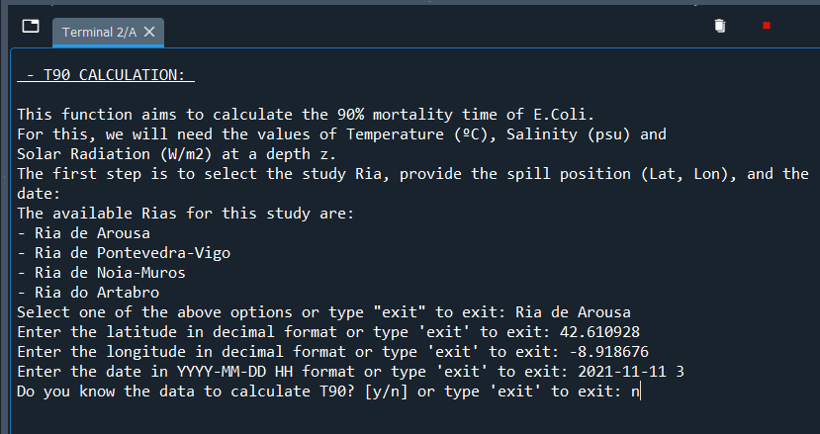
Case 2: Consulting case
When the code is run again, all downloaded maps and files will be automatically deleted to avoid file reading errors.
Introduce the latitude, longitude and the date. But then, enter 'y' to the question because we don't know the data.

Slide 15
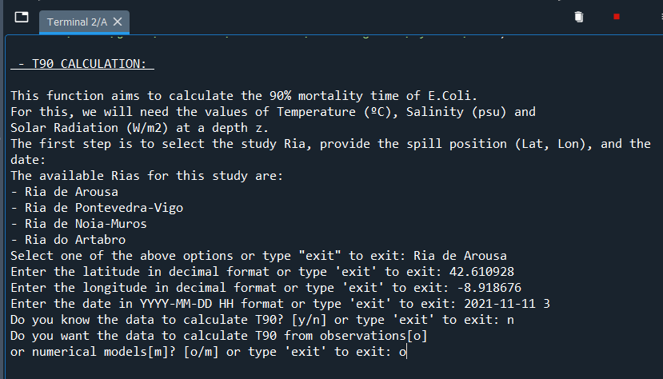
Case 2: Consulting case
The user is then asked to choose whether to obtain the data from observations or from models.
The user is always recommended to choose observations.

Slide 16
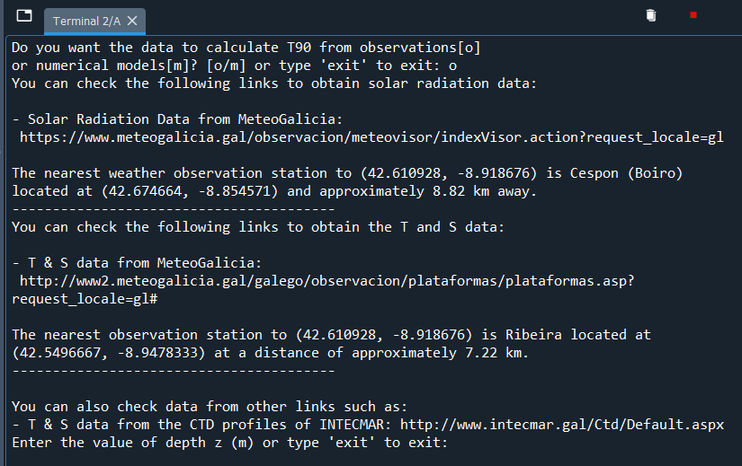
Case 2: Consulting case
Once introduced, the user is shown several direct links from which to consult the data needed to be entered.
In addition, as there are several observation stations, the user is shown the nearest station to consult in order to obtain the data.

Slide 17
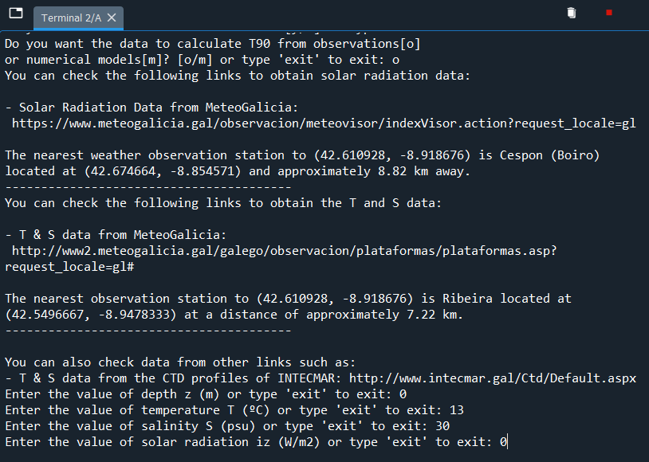
Case 2: Consulting case
For simplicity, let us assume that the data are the same as for the previous case.
Once entered, the same would be displayed as from slide 8.

Slide 18
Additional information
It is not recommended to use the option of obtaining data from models because of its complexity.
The procedure consists of consulting the MeteoGalicia database, downloading and reading the data from a specific file, but sometimes these data are not available or not analyzable (NaN).
In addition there could be problems with the data file formats, favoring the appearance of errors.

